Slide 1
10.6 PYSINDY (with reduced original system)
AYAN DEEP HAZRA

Slide 2
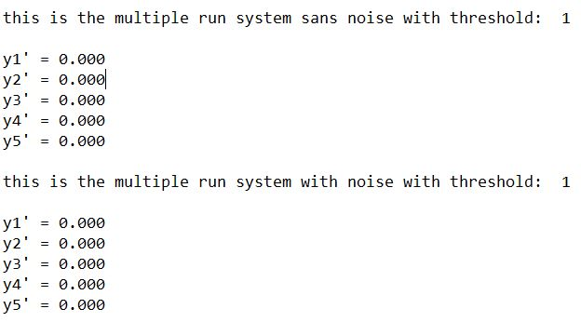
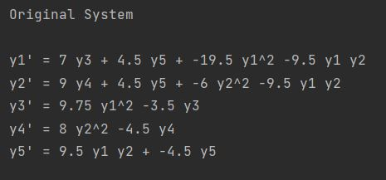
Threshold = 10^0

Slide 3
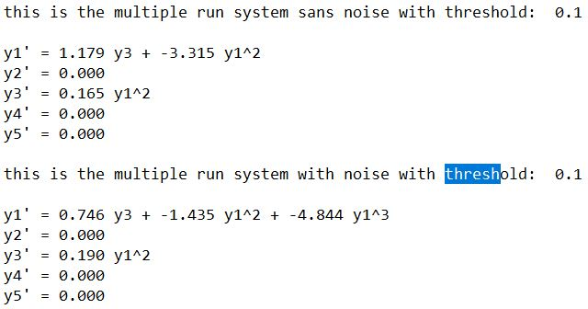
Threshold = 10^-1

Slide 4
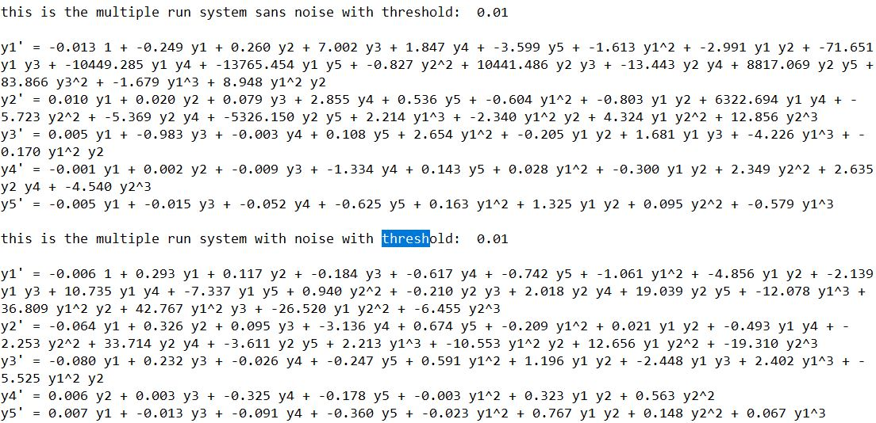
Threshold = 10^-2

Slide 5
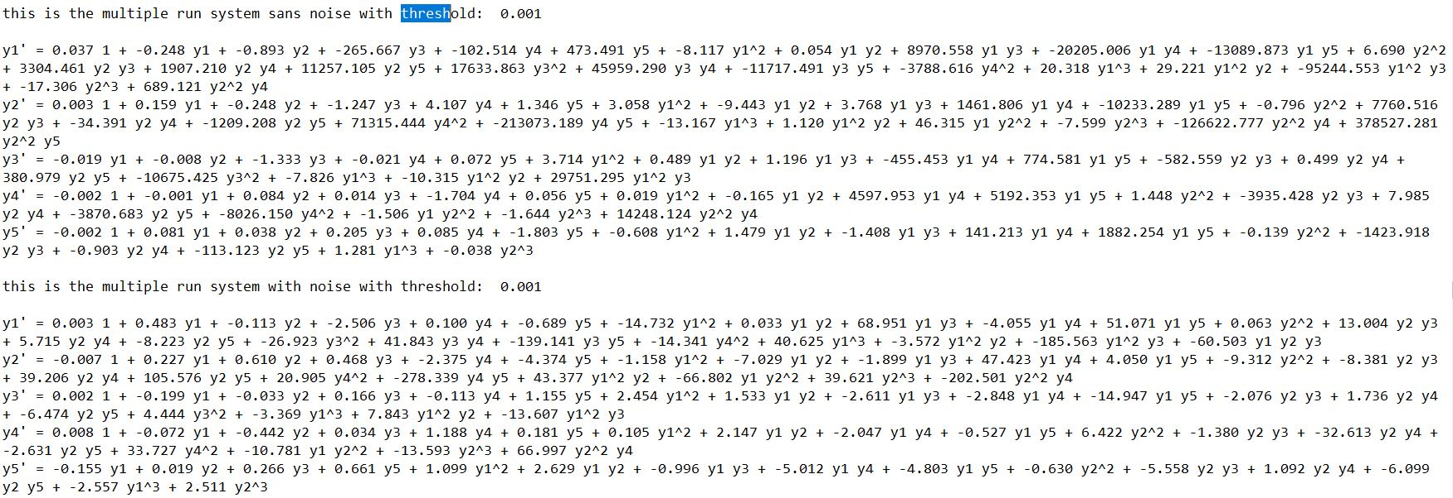
Threshold = 10^-3

Slide 6
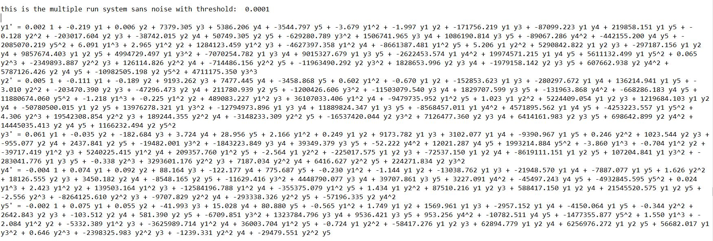
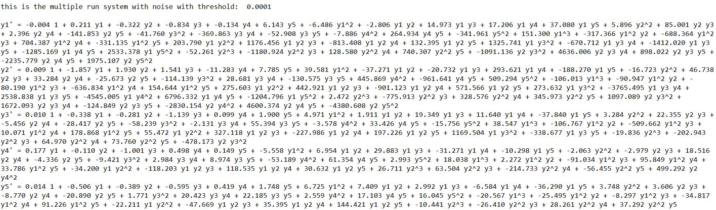
Threshold = 10^-4

Slide 7
Forward simulation
Using Siddharth’s suggestions
Will have to keep working on it

